Slide 1

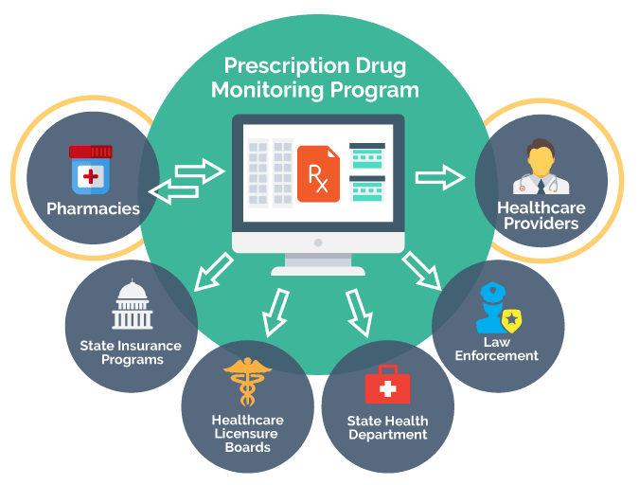
George Mason University 2024
What is Prescription Drug Monitoring Programs (PDMPs)?
It is a program used in the Emergency Department (ED) that have been proven to inform and improve opioid prescribing practices, therefore, reducing the number of opioid prescriptions written.
Dataset Source: Washington State Department of Health
Data on controlled substances (Schedule II–V).
Relevance to Public Health: Prescription drug misuse, particularly of opioids (such as Hydrocodone and oxycodone), is a critical public health concern. This dataset allows an in-depth exploration of patterns and behaviors contributing to this issue.
Comprehensive Scope: It contains detailed records spanning multiple years, enabling the analysis of trends and temporal changes.
Research Significance: Understanding patterns in controlled substance prescriptions can support efforts to mitigate prescription misuse and inform public health strategies.
“Prescription Drug Monitoring Program”
Prepared by - Vivek Sarvagod (G01509191)
10 December 2024
INFS 580 – Big Data to Information
Notes:
Hello, Welcome to my final project presentation on PDMP dataset.
<click
It is a program used in the Emergency Department (ED) that have been proven to inform and improve opioid prescribing practices, therefore, reducing the number of opioid prescriptions written.
Although this program is Implemented in 49 states, these databases track Schedule 2-5 controlled medications and generate an individual report for each patient listing all prescriptions written in the past year, including dosage given to a patient, prescriber information, pharmacy details, and date on which medication is prescribed.
This information can help Emergency Departments (ED) physicians to identify opioid misuse, abuse, or diversion.
Most common Opioid drugs are Hydrocodone and oxycodone
and both the drugs can be highly addictive if not taken as prescribed
Washington:
It includes information such as drug class, dosage, prescription dates, geographic regions, prescribers, and patient demographics.
The dataset is publicly available and provides a rich source of data for analyzing prescription patterns, high-risk prescribing behaviors, and potential areas of intervention
Relevance to Public Health: This dataset allows an in-depth exploration of patterns and behaviors contributing to this issue.
Comprehensive Scope: It contains detailed records spanning multiple years, enabling the analysis of trends and temporal changes.
It has a comprehensive Research Significance: By Understanding patterns in controlled substance prescriptions this research can support to mitigate prescription misuse and inform public health strategies.
Now "click"

Slide 2

Research Questions
George Mason University 2024
Trends Over Time
Schedule-Specific Patterns
What trends can be observed in the prescription of controlled substances in Washington State over the years?
How do the dispensing patterns of Schedule II-V drugs vary across time and geographic regions?
Daily MME Risks
Abuse Potential Trends
What percentage of prescriptions exceed recommended daily morphine milligram equivalents (MME)?
How has the dispensing of drugs with high abuse potential (e.g., opioids, benzodiazepines) changed over time?

Slide 3
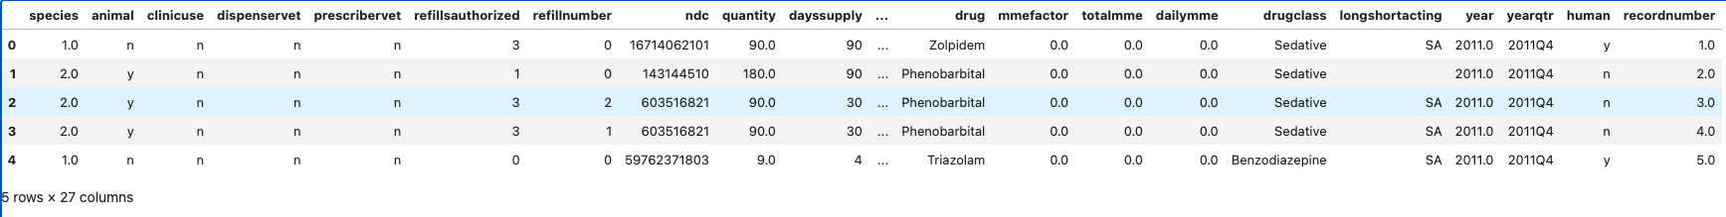
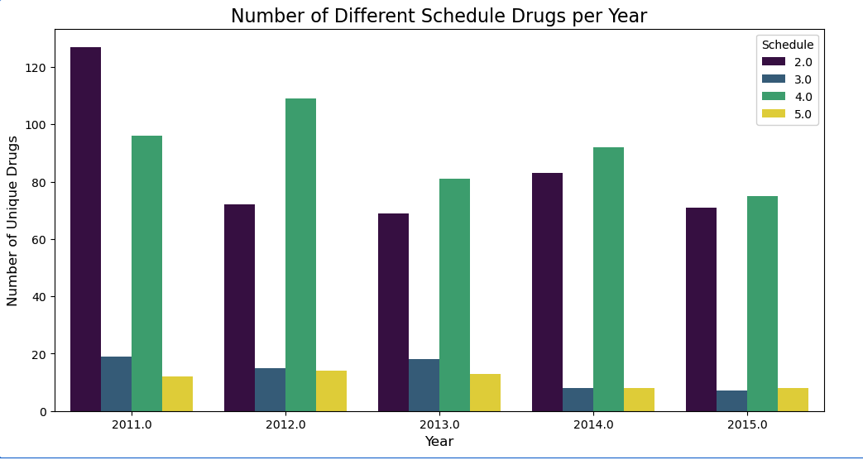
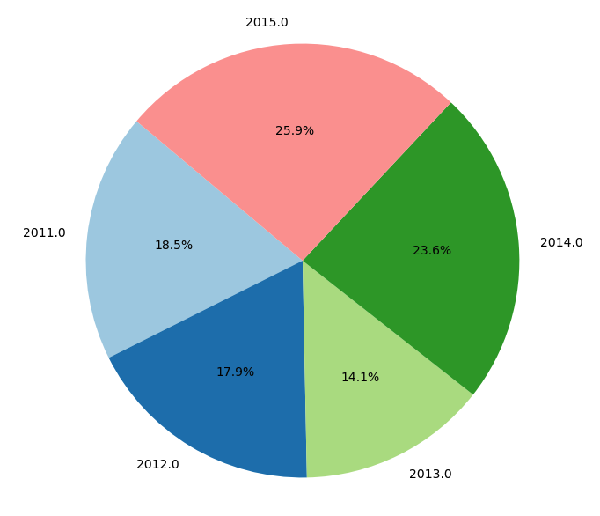
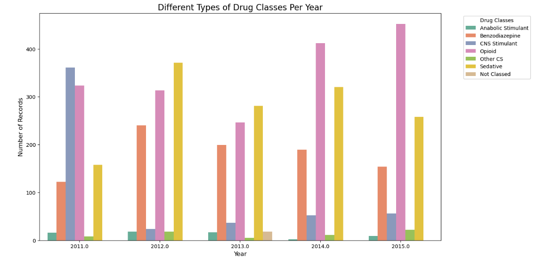
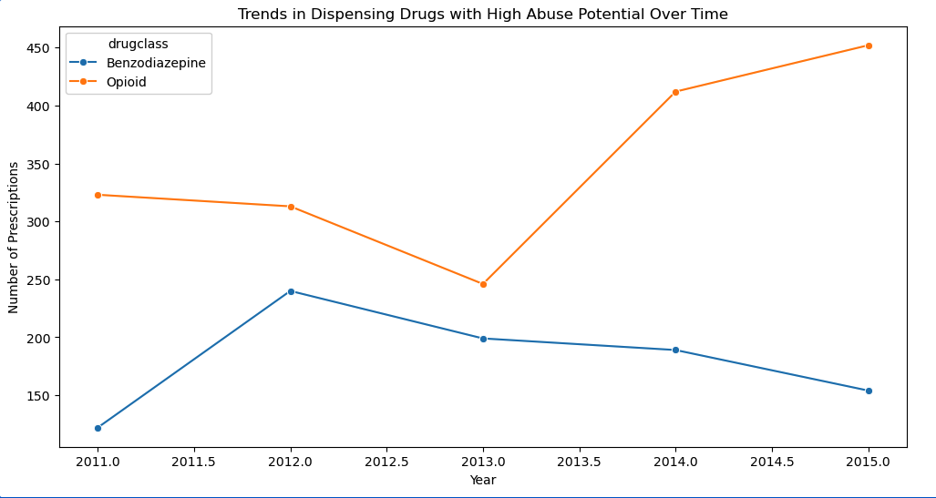
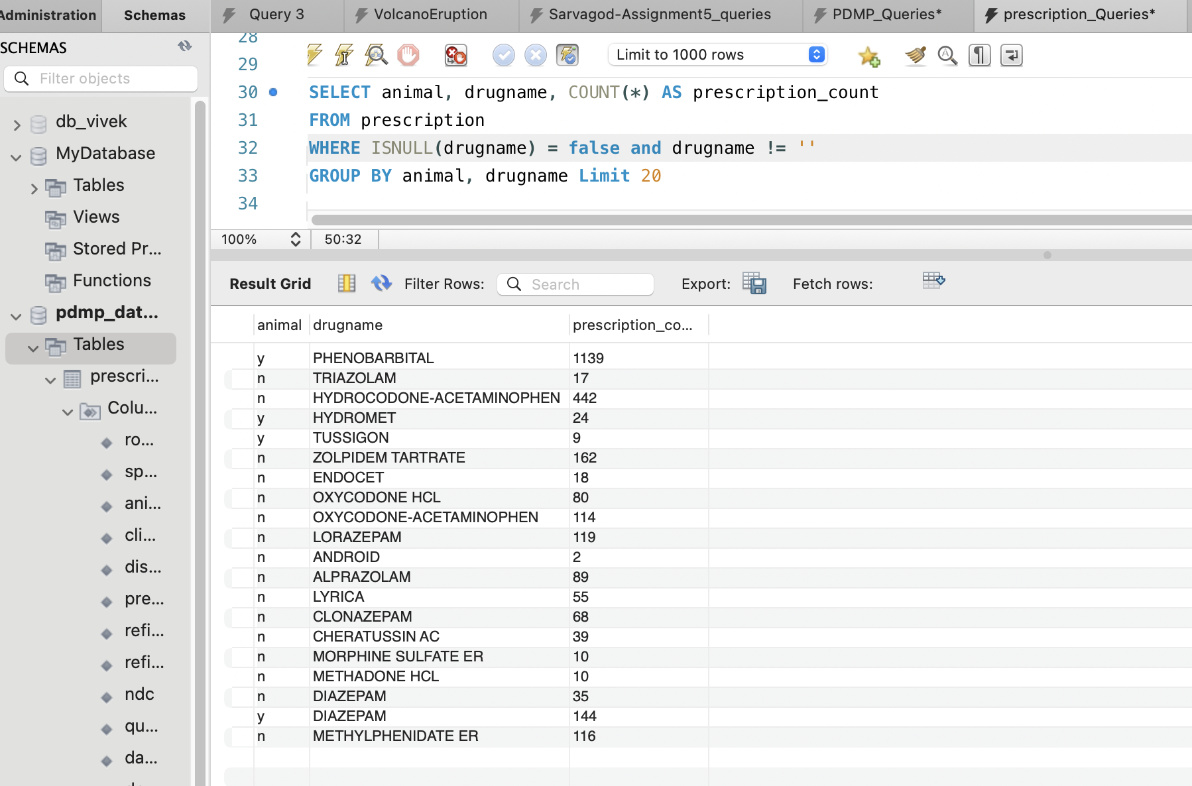
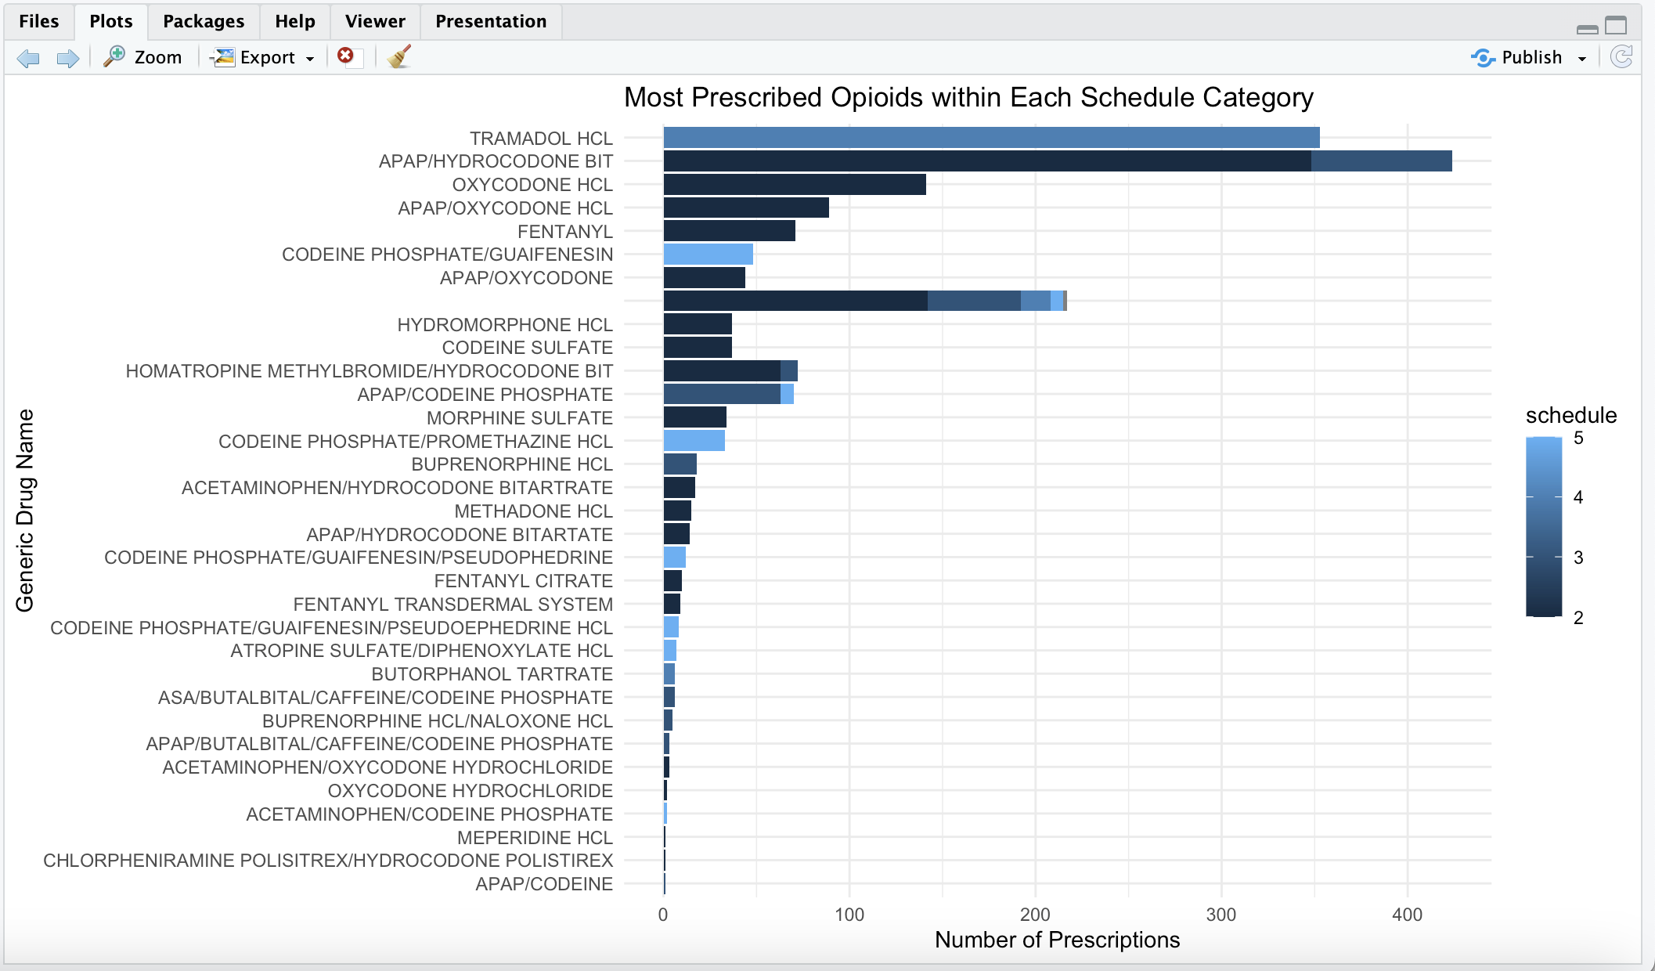
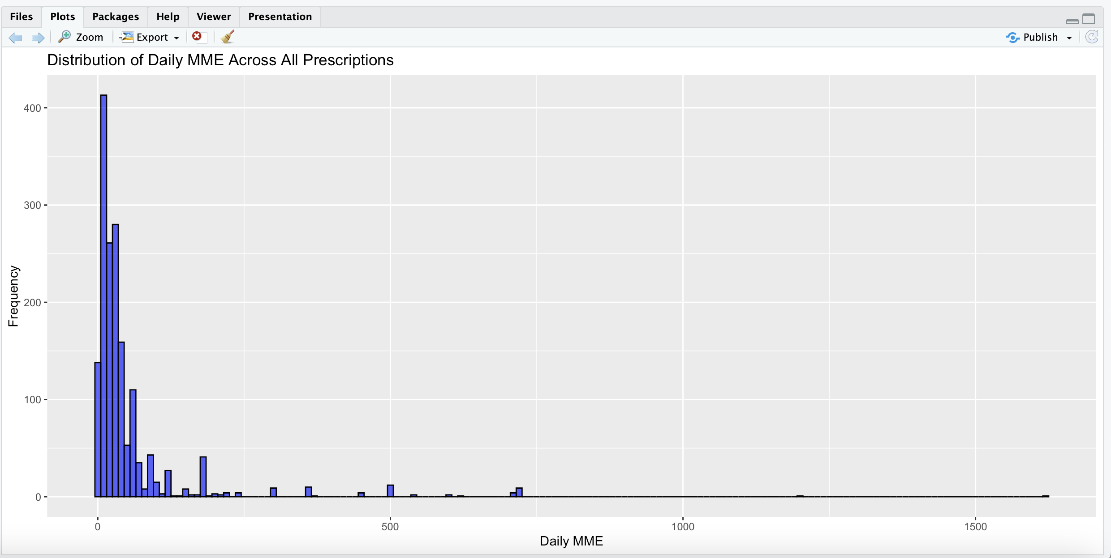
Methodology
1. Data Cleaning:
Using Python any missing values in the dataset was addressed by imputing 0 for numerical fields and blank ("”) for categorical fields.
Irrelevant or redundant columns were removed to ensure focus on key variables.
2. Descriptive Statistics:
Summarized key metrics such as prescription counts, drug schedules, and dosage distributions.
Explored trends in prescribing behavior over time and across regions.
3. Visualization:
Tools used such as Python and R.
Bar plots highlighted the most prescribed drugs and distribution across schedules.
4. SQL Integration:
Structured and queried the dataset in MySQL for advanced analytics, focusing on data subsets and trend evaluation.
5. AWS Analysis:
Used S3 bucket to stored the dataset.
QuickSight Athena used to Performed analysis on dataset by executing SQL scripts
Created time-series graphs, scatterplots, and pie charts to visualize drug usage trends and regional patterns.
George Mason University 2024

Slide 4

Key Findings
Trends in Controlled Substances:
A consistent rise in prescriptions for Schedule II drugs (opioids) was observed from 2010–2017, followed by a decline likely influenced by policy changes.
Scheduled-II prescriptions showed a steady usage rate with minor fluctuations.
Regional Variations:
Certain counties displayed higher prescription rates for opioids, suggesting localized high-risk areas.
High-Risk Patterns:
Strong correlations were identified between the number of prescribers and high-volume prescriptions, suggesting possible doctor shopping or overprescribing.
Drug-Specific Insights:
Hydrocodone and oxycodone were the most prescribed opioids, while alprazolam topped the benzodiazepine prescriptions.
Exceeding MME Guidelines:
Over 20% of opioid prescriptions exceeded the recommended daily MME, presenting potential risks of addiction or misuse.
George Mason University 2024

Slide 5

George Mason University 2024
Lessons Learned and Conclusion
Data Challenges :
Handling missing or incomplete records required significant preprocessing.
Missing demographic information.
Discrepancies in regional data highlighted the need for better standardization in data collection.
Insights Gained :
Significant variance in opioid prescribing across areas and demographics, as well as notable patterns in the distribution of high-risk Schedule II medicines.
Policy changes (e.g., stricter MME limits) significantly impacted prescription behaviors.
Opportunities for Improvement :
Incorporating external data, such as overdose reports or demographic insights, could enhance the analysis.
Engaging with domain experts could refine the interpretation of high-risk patterns.
Broader Implications :
The findings underscore the importance of monitoring and regulating prescriptions to reduce misuse.
Public health campaigns tailored to high-risk regions could have a substantial impact.
Notes:
Conclusion:
The findings of this study can help to build early warning systems, improve regulatory frameworks, and drive public health activities targeted at reducing the dangers associated with controlled substance use. Policymakers, healthcare professionals, and academics can use this dataset to make educated decisions about the current opioid crisis and encourage safer prescribing practices.
+The analysis of the Washington State Prescription Monitoring Program (PMP) dataset provides essential insights into restricted substance prescribing and dispensing patterns, revealing trends that might affect public health policy and clinical practice. Over time, controlled substance prescriptions have fluctuated in response to legislative changes, public health efforts, and provider practices.
While the dataset serves as a solid platform for evaluating prescription patterns, limitations like as missing data, privacy restrictions, and a lack of health outcomes underscore the need for additional datasets and improved approaches. Future research should concentrate on combining PMP data with public health records, using predictive analytics, and addressing data standardization and completeness concerns.

